Slide 1

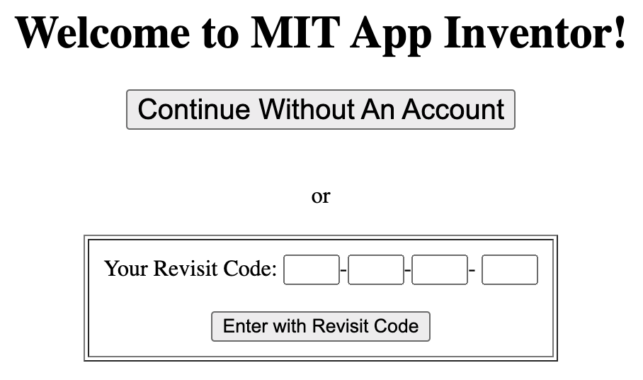
Translate English to German
Create an app to help you learn German
1
Open Google Chrome browser and type the URL https://code.appinventor.mit.edu in the address bar of the browser
Following Screen appears in response of the step 1
2
Click “Enter with Revisit Code” after entering your code.
15th Nov 2023

Slide 2
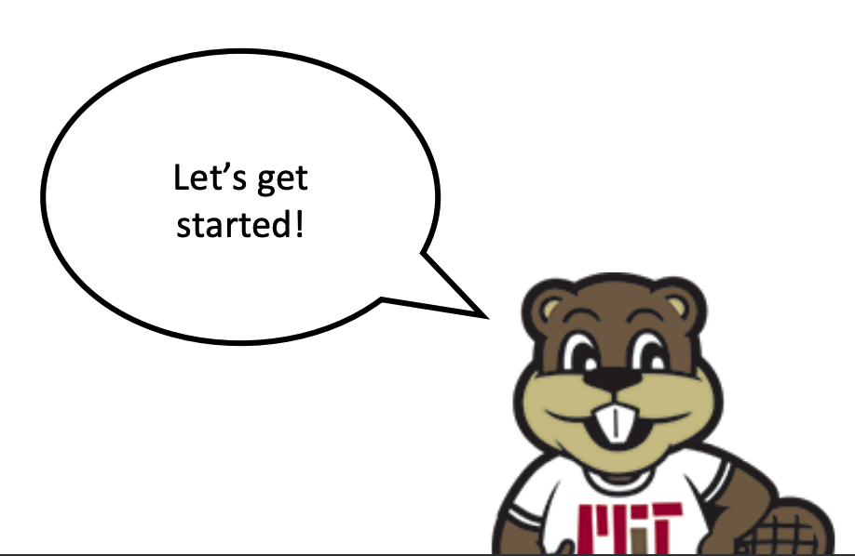
App Overview:
When you are done you and your friends will be able to use this app to:
Type a word or phrase in English and translate it to written German
Have your phone read the translated text out loud in German
15th Nov 2023

Slide 3
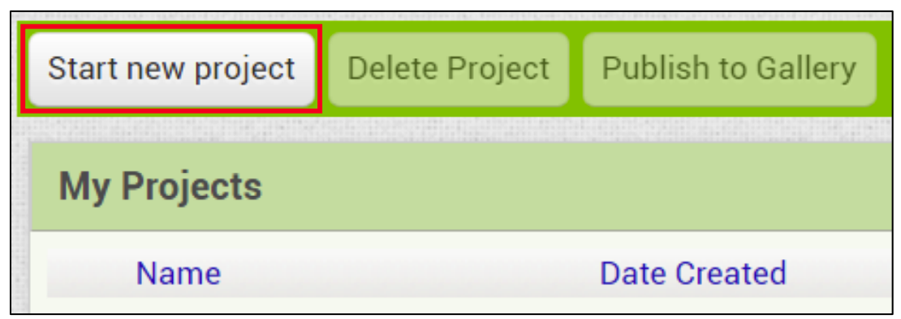
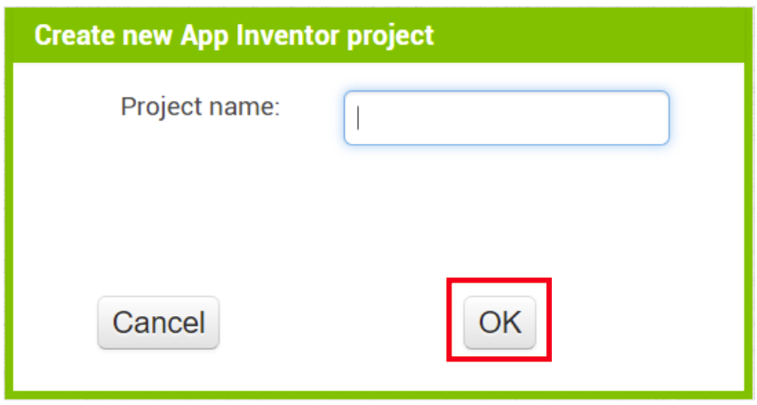

3
Click “Start a new Project” in the upper left corner
For this tutorial you can call your app EnglishtoSpanish
4
Give it a name and click “OK” to get started!
15th Nov 2023

Slide 4
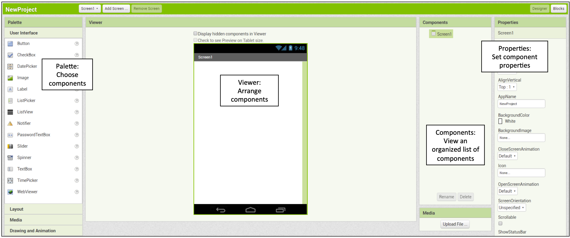
5
Familiarize yourself with the designer window
15th Nov 2023

Slide 5
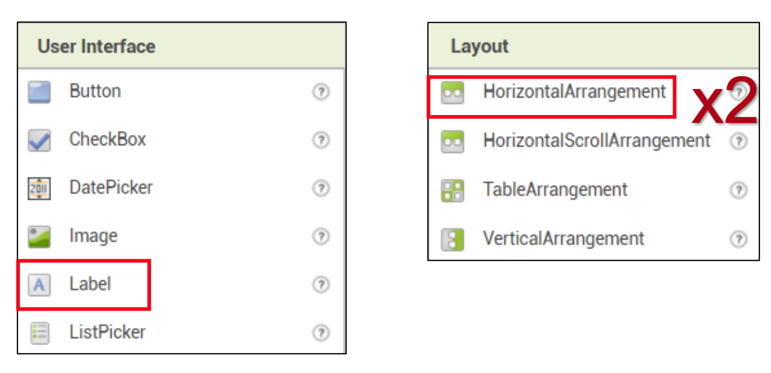
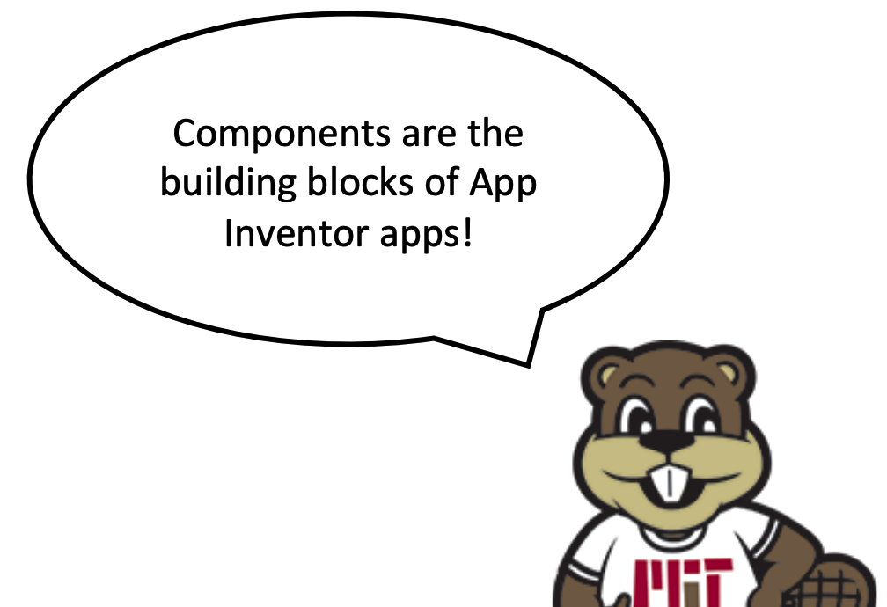
6
Add Components
First, we will build the app’s layout by adding three components –a Label, and two HorizontalArrangements. Find these components in the Palette and drag and drop them onto the Viewer.
15th Nov 2023

Slide 6
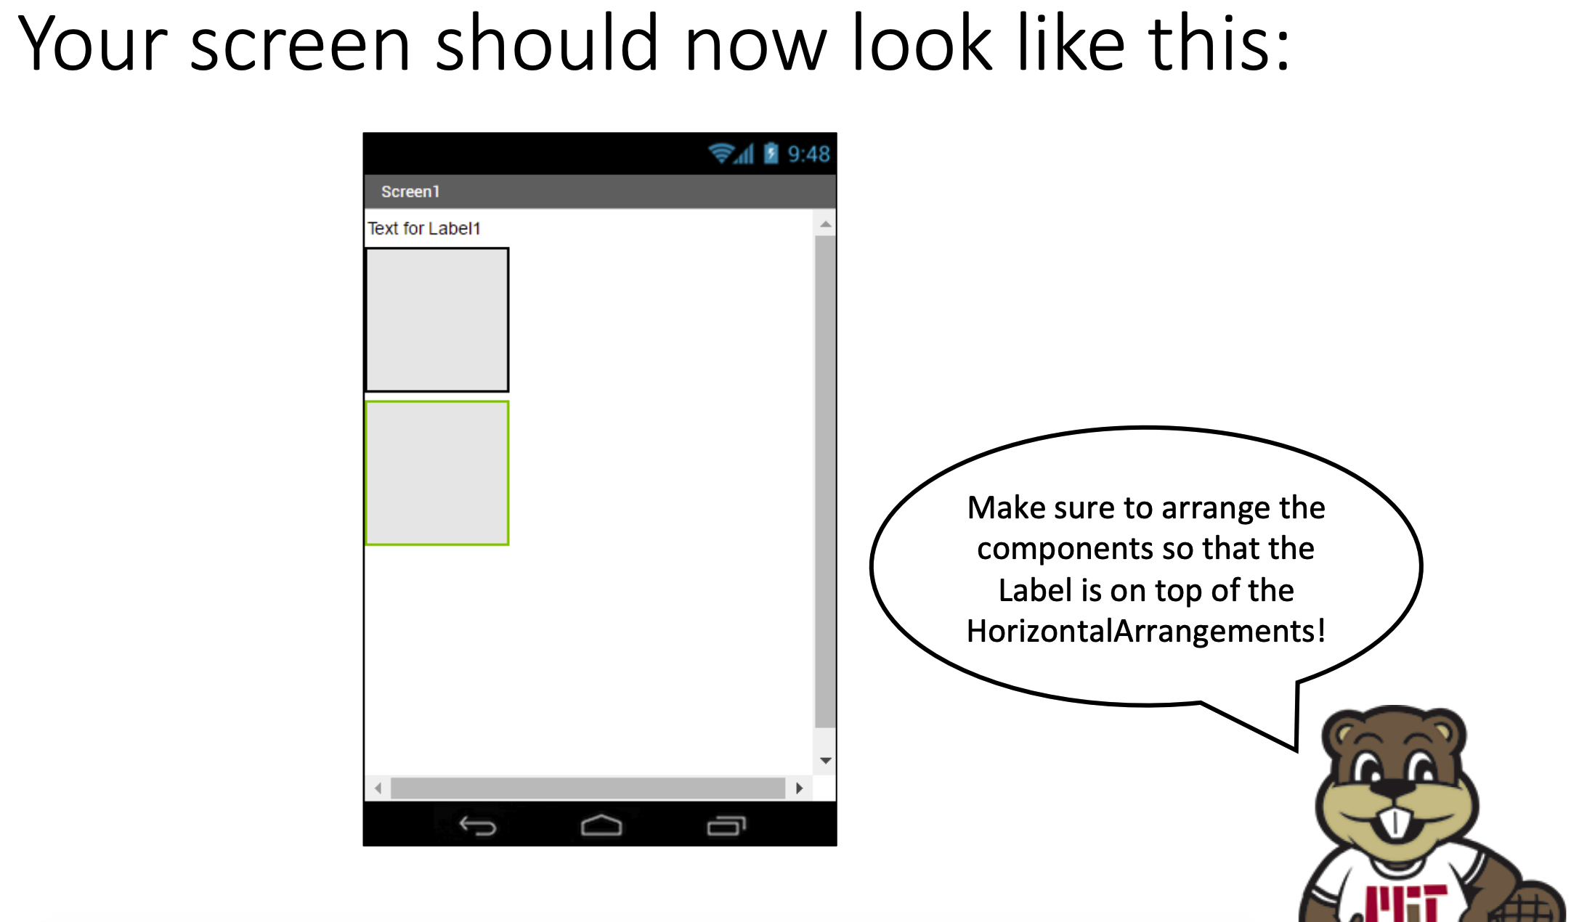
15th Nov 2023

Slide 7
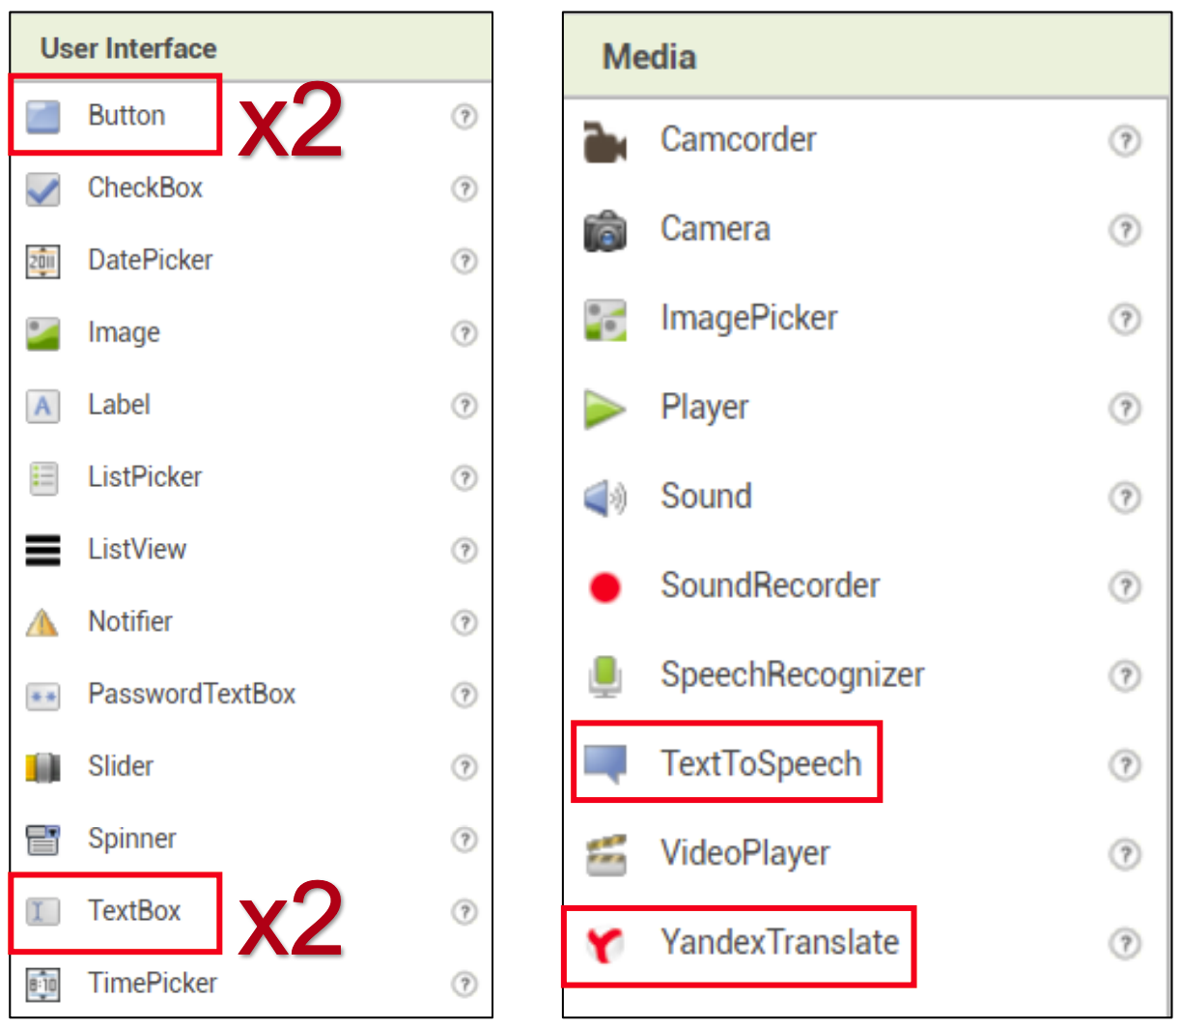
6
Continued …
Now we will add the rest of the components. We will need six more in total—two TextBoxes, two Buttons, one YandexTranslate, and one TextToSpeech. Find these components in the Palette and place them in the view – don’t worry about where you put them for now!
15th Nov 2023

Slide 8
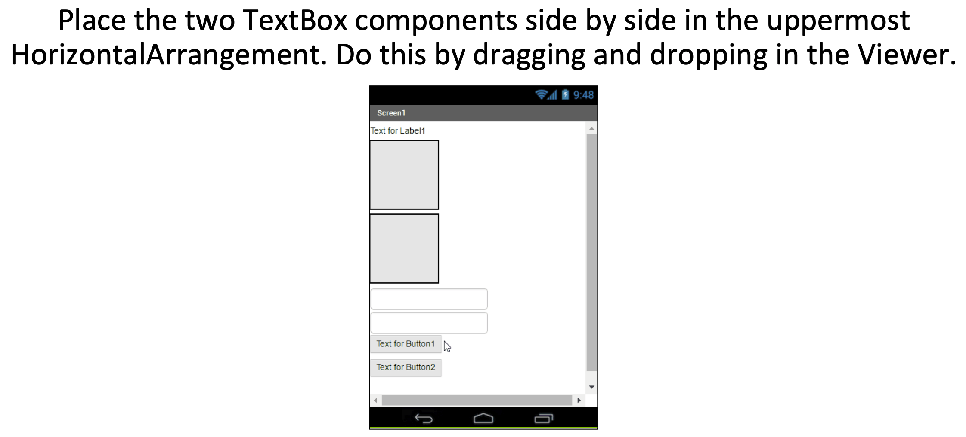
6
Continued: Layout
15th Nov 2023

Slide 9
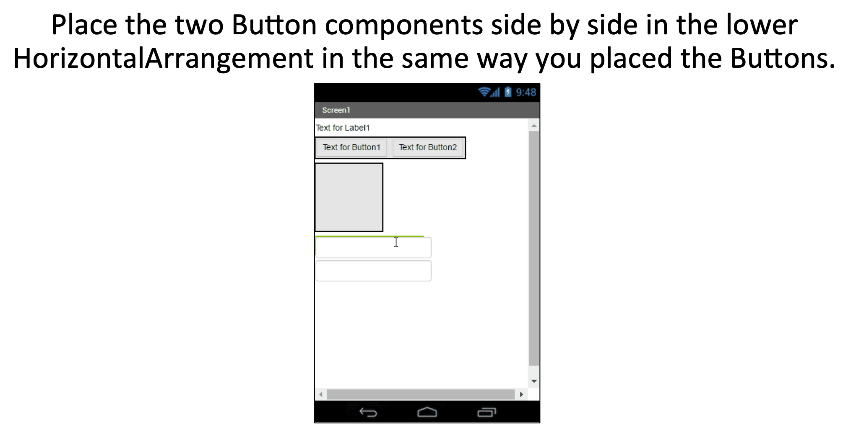
6
Continued: Layout
15th Nov 2023

Slide 10
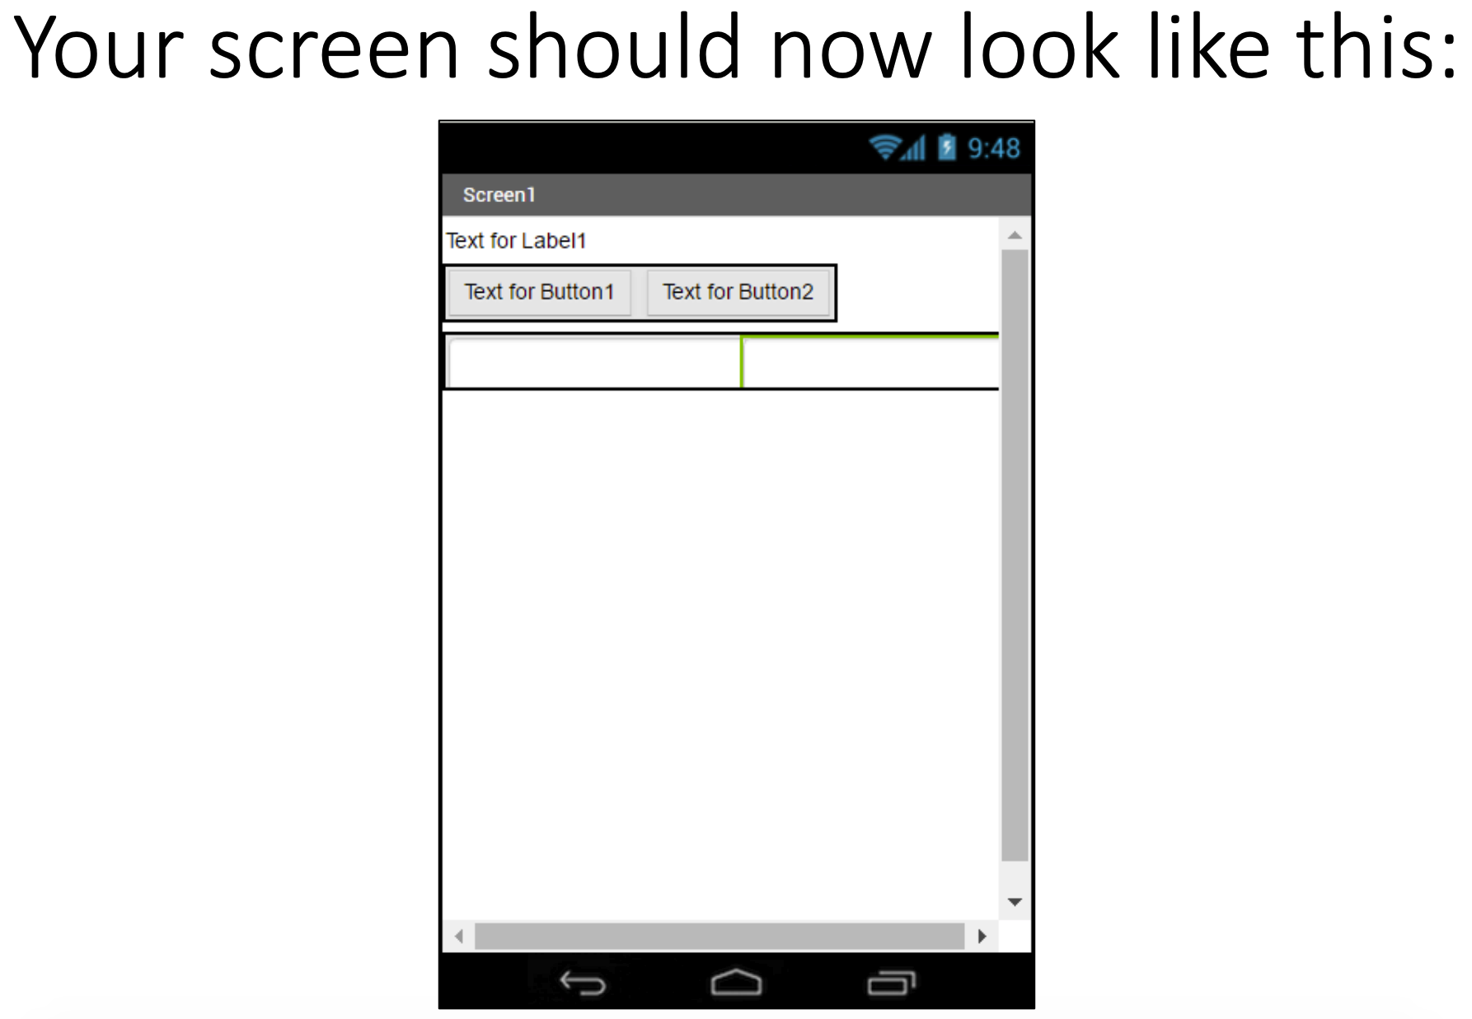
15th Nov 2023

Slide 11
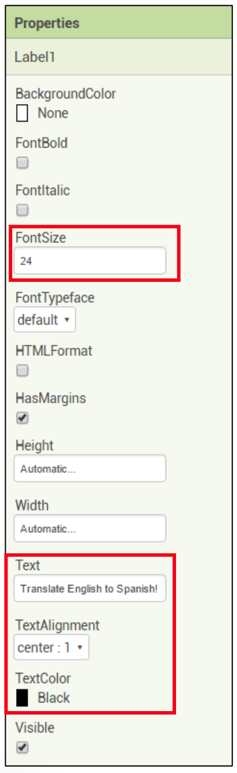
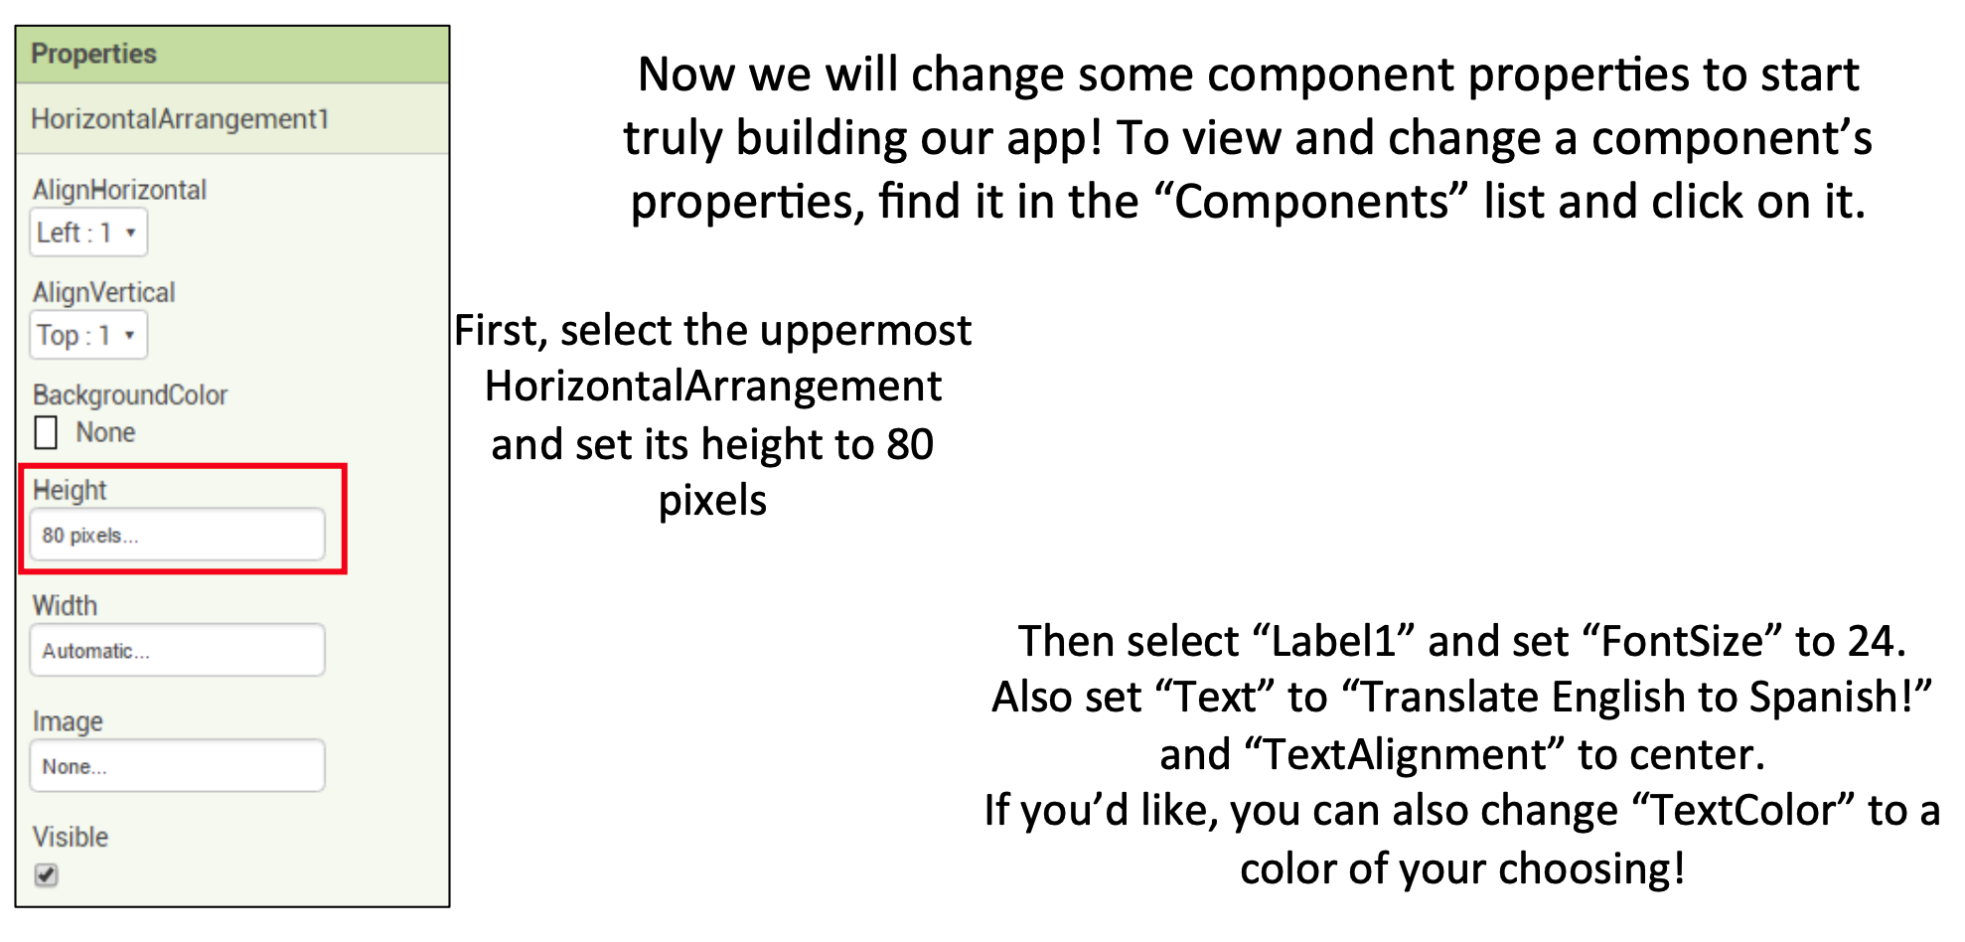
7
Set Properties
German!
15th Nov 2023

Slide 12
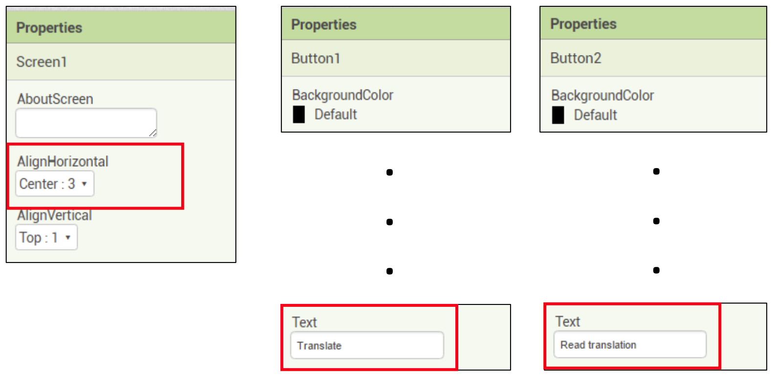
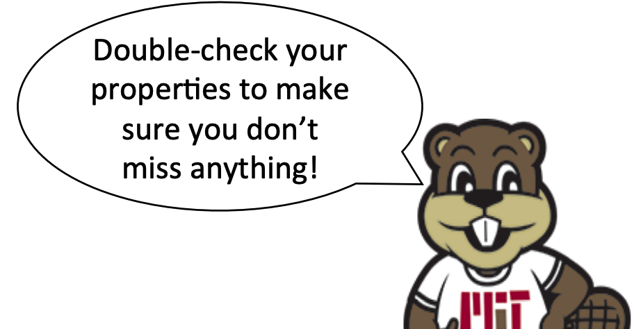
7
Continued …
Now we just a few more properties to set – centering the screen and adding text to both of our buttons! First, set “Text” of Button1 to “Translate” and “Text” of Button2 to “Read translation.” Then click on “Screen1” and set “AlignHorizontal” to “Center”
15th Nov 2023

Slide 13
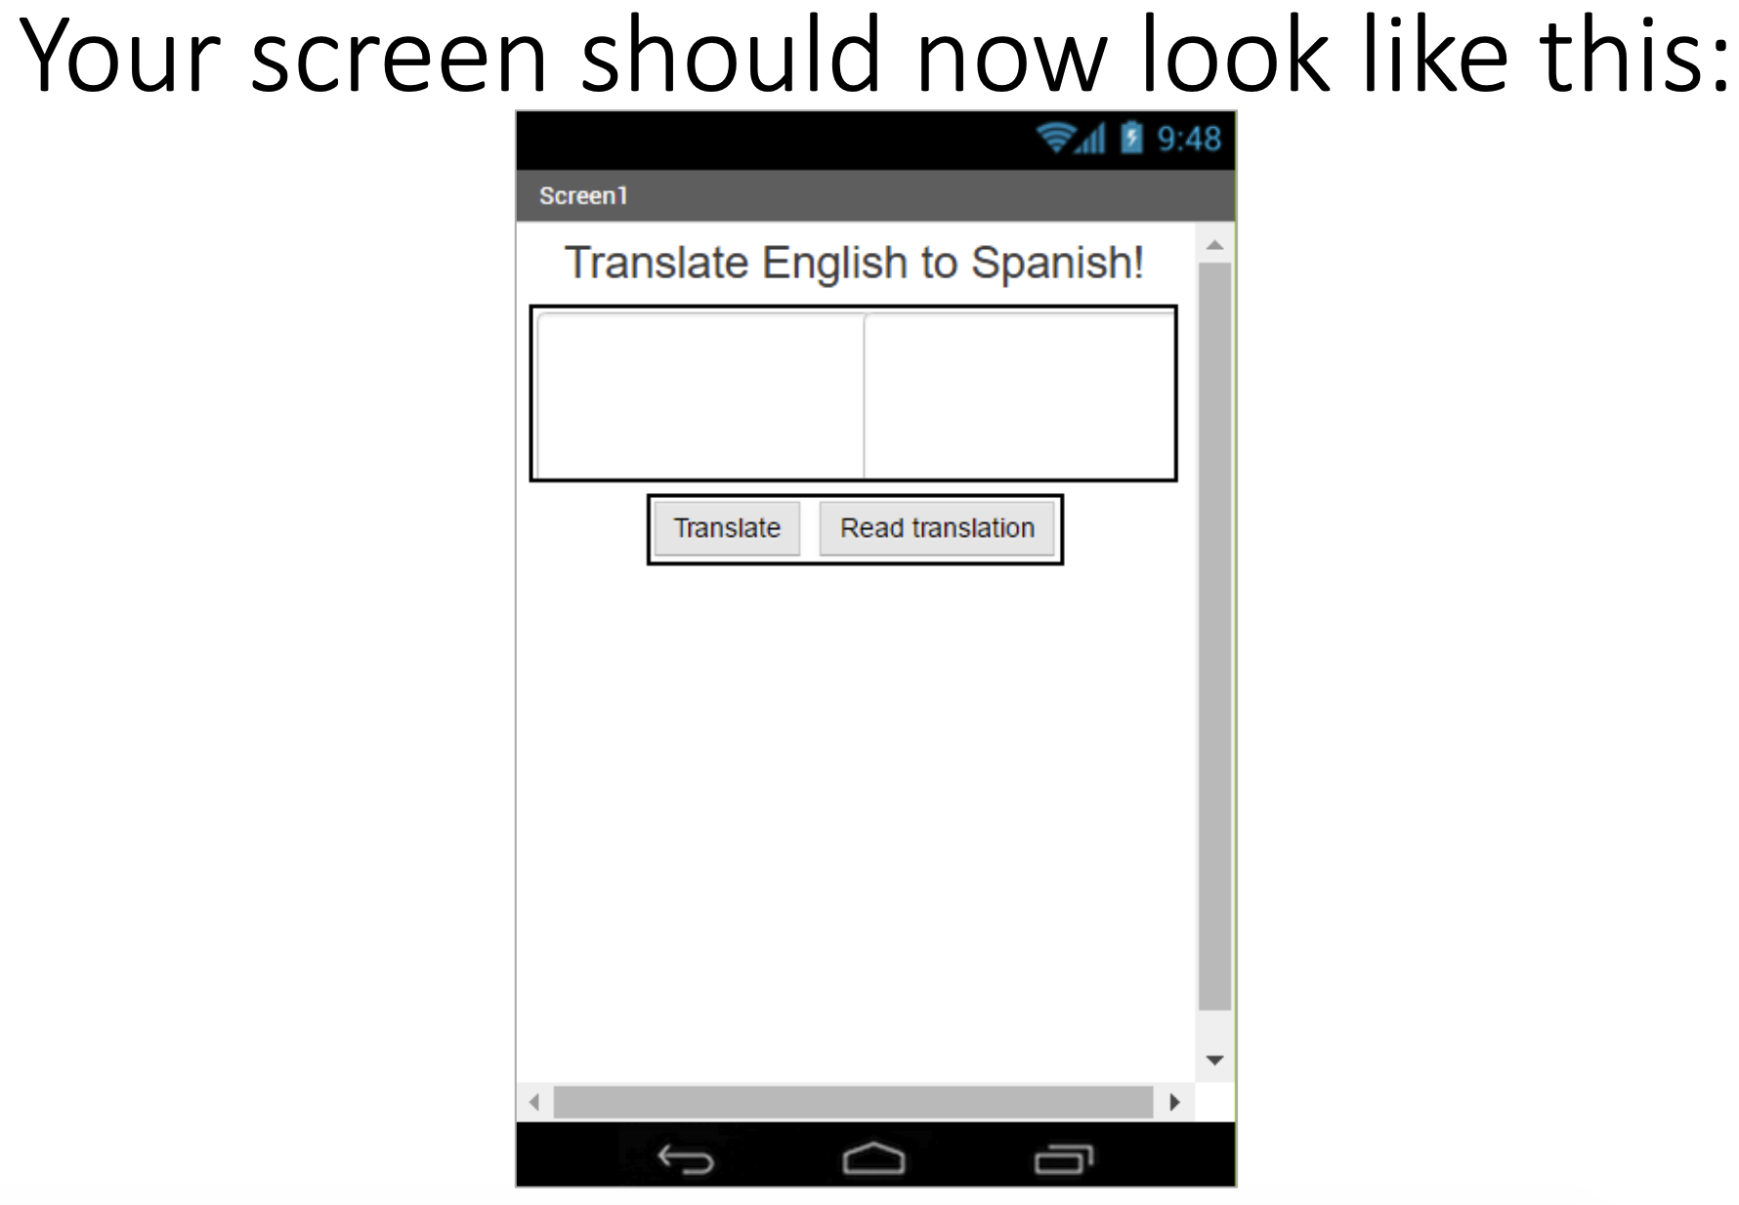
German!
15th Nov 2023

Slide 14
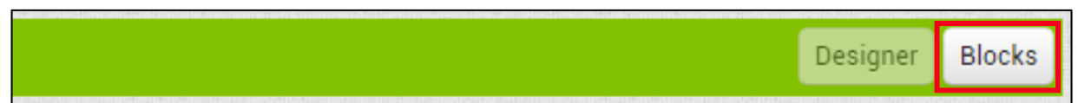
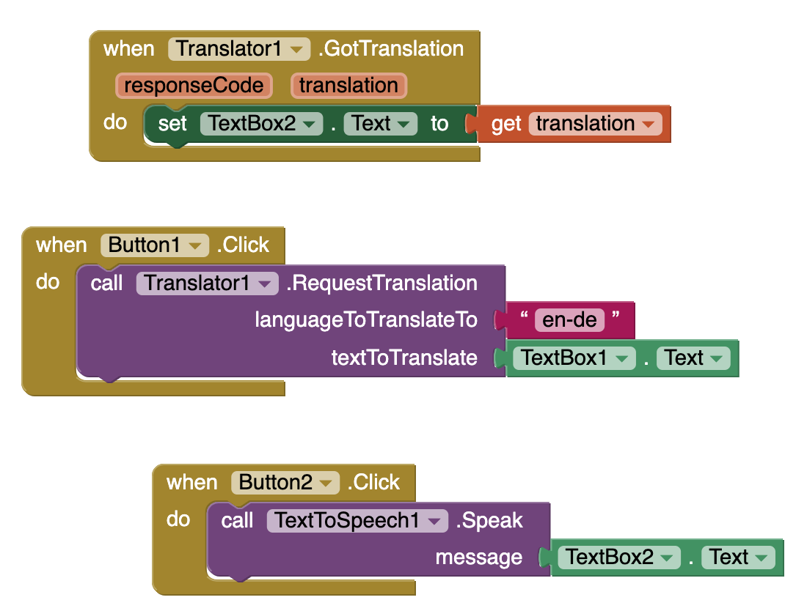
8
Switch to the blocks window to write code!
Now that all the components have been added to the app, we will write code to tell app what to do with them! To do so, switch to the Blocks Editor window by clicking the “Blocks” button in the upper right corner.
Required blocks for the app
9
TEST: Device/Emulator
15th Nov 2023

Slide 15

Great work! Now extend this app
Here are some ideas for extending this app. You can probably think of many more!
Challenge 1: Change language and see how it works
Suggestions for Further Exploration
Translation app to read paragraph of text
Learn international translation codes available for different languages
15th Nov 2023

